Slide 1
Speaking & Listening Booster Webinar
Tutor: Rebecca Roberts

Slide 2
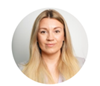





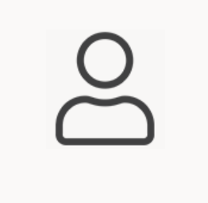
Meet the Functional Skills Team
Functional Skills Lead
Sally- Anne Feather
Functional Skills Coordinator
Rebecca Bissett
Functional Skills Maths Tutor
Kathleen MacDonald MA FFA CERA
Functional Skills English Tutor
Rebecca Roberts
Functional Skills Admin
Shanhary Suthaharan
Functional Skills Admin
Camille Maltais
Functional Skills Admin
Anneka Haskins

Slide 3
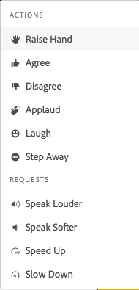
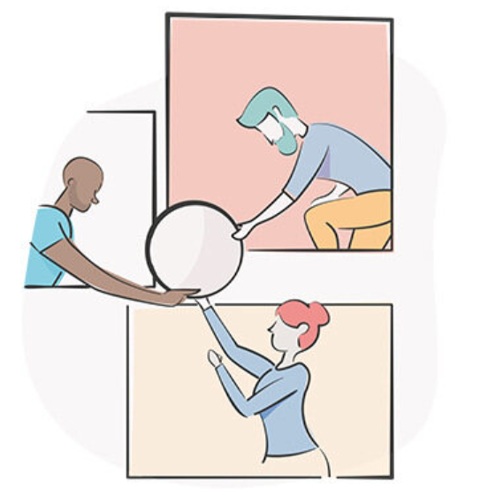
How to Work Adobe Connect

Slide 4
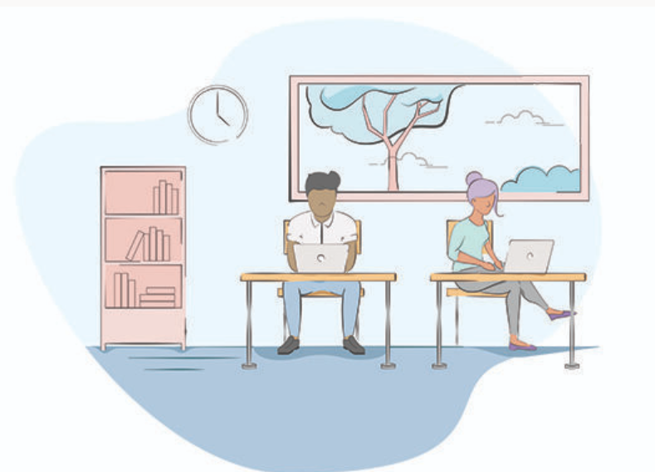
Webinar Objectives
Have a clear understanding of the three-part speaking and listening assessment at Level 2
Observe a Speaking & Listening assessment in practice
Complete tasks to help enhance your understanding of the Speaking & Listening assessments.
Opportunity to ask all your questions

Slide 5
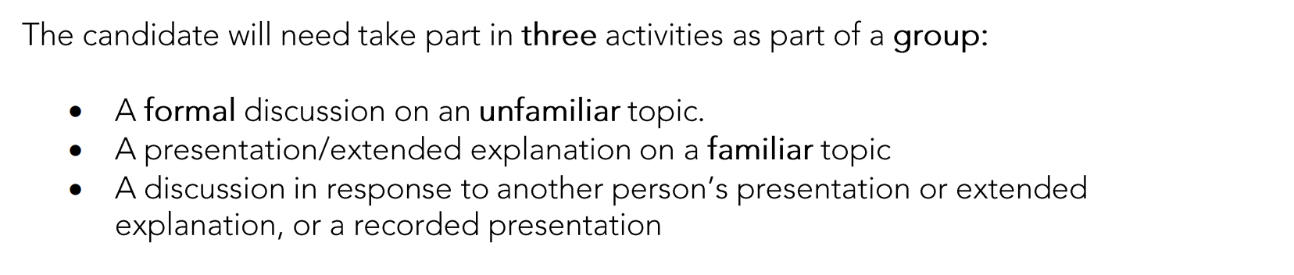

Slide 6
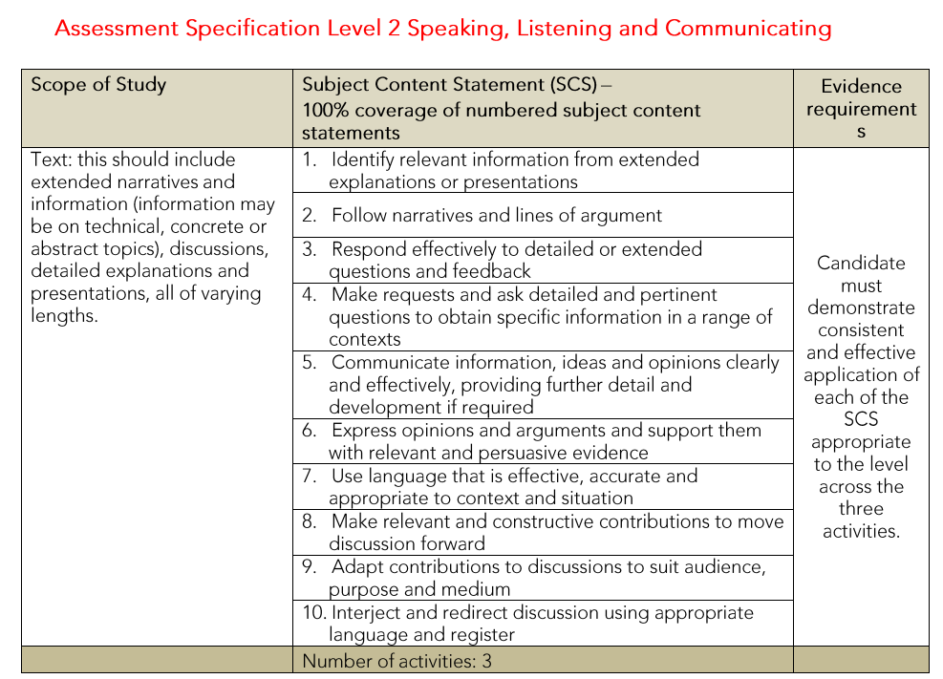

Slide 7
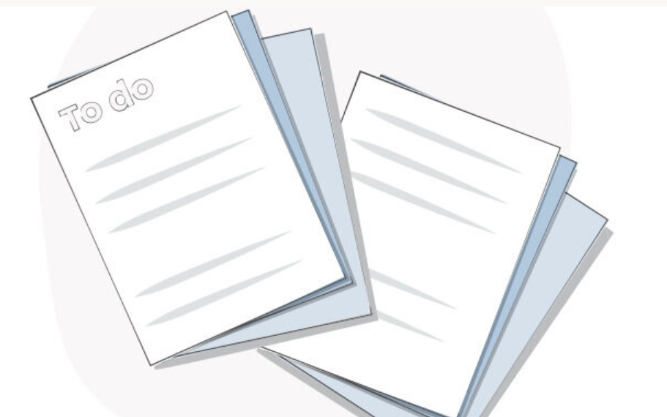
Pre- Speaking & Listening Assessment?
To complete your Speaking & Listening assessment you will attend a 2-hour Microsoft Teams online meeting. This will be booked through the Functional Skills inbox- FunctionalSkills@bpp.com.
You need to make sure you have planned for all assessments; you need to prove that you have planned and considered your contributions and responses to an informal discussion on an unfamiliar topic and formal presentation on a familiar topic. You will need to provide at least two forms of research for each assessment

Slide 8
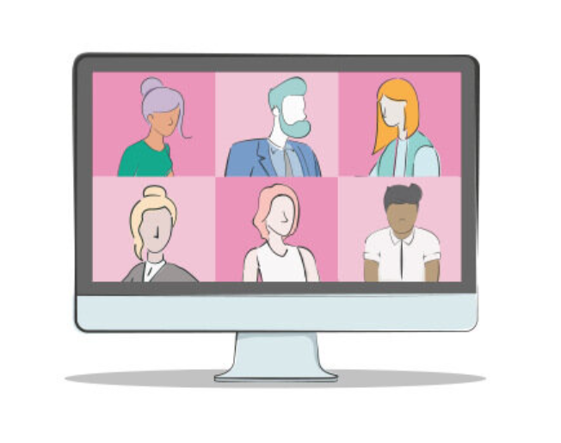
What to expect during your S&L assessment?
Introductions, revisit assessment criteria, outline for the assessment (ID checks, City and Guilds enrolment numbers)
Informal assessment (Recorded)
Break
Formal assessment (Recorded)

Slide 9
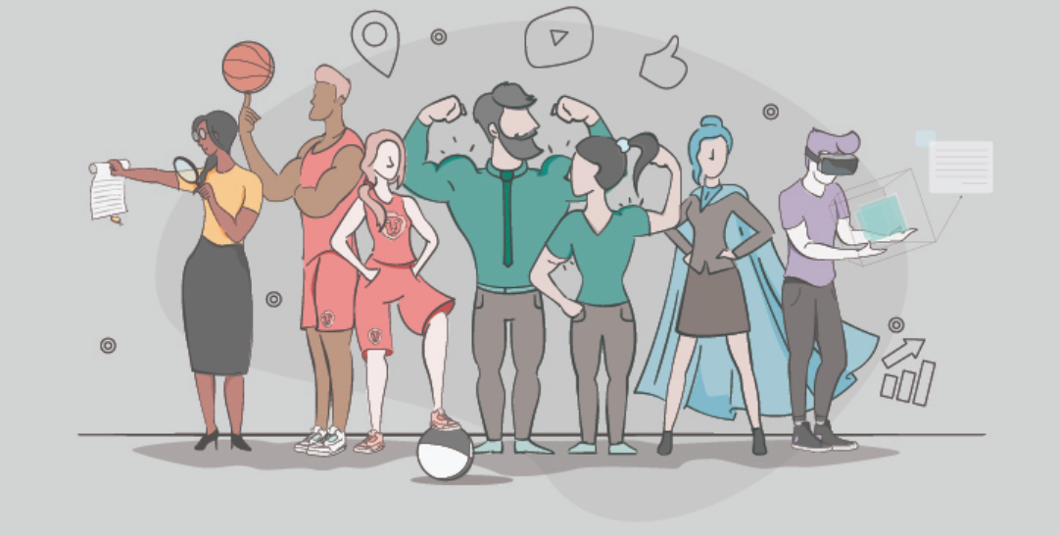
Video- Demo of Speaking & Listening Assessment
Link- https://www.youtube.com/watch?v=VCOVV449J7g

Slide 10
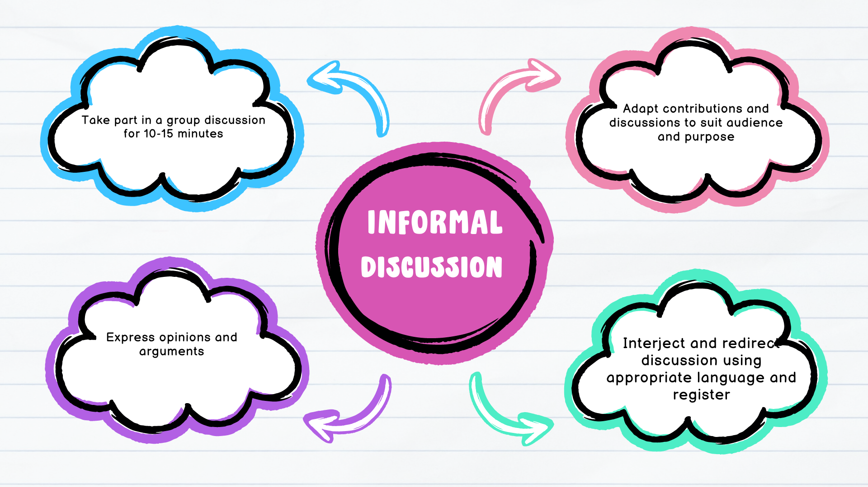
Informal Discussion (Groups of 3-5 learners)

Slide 11
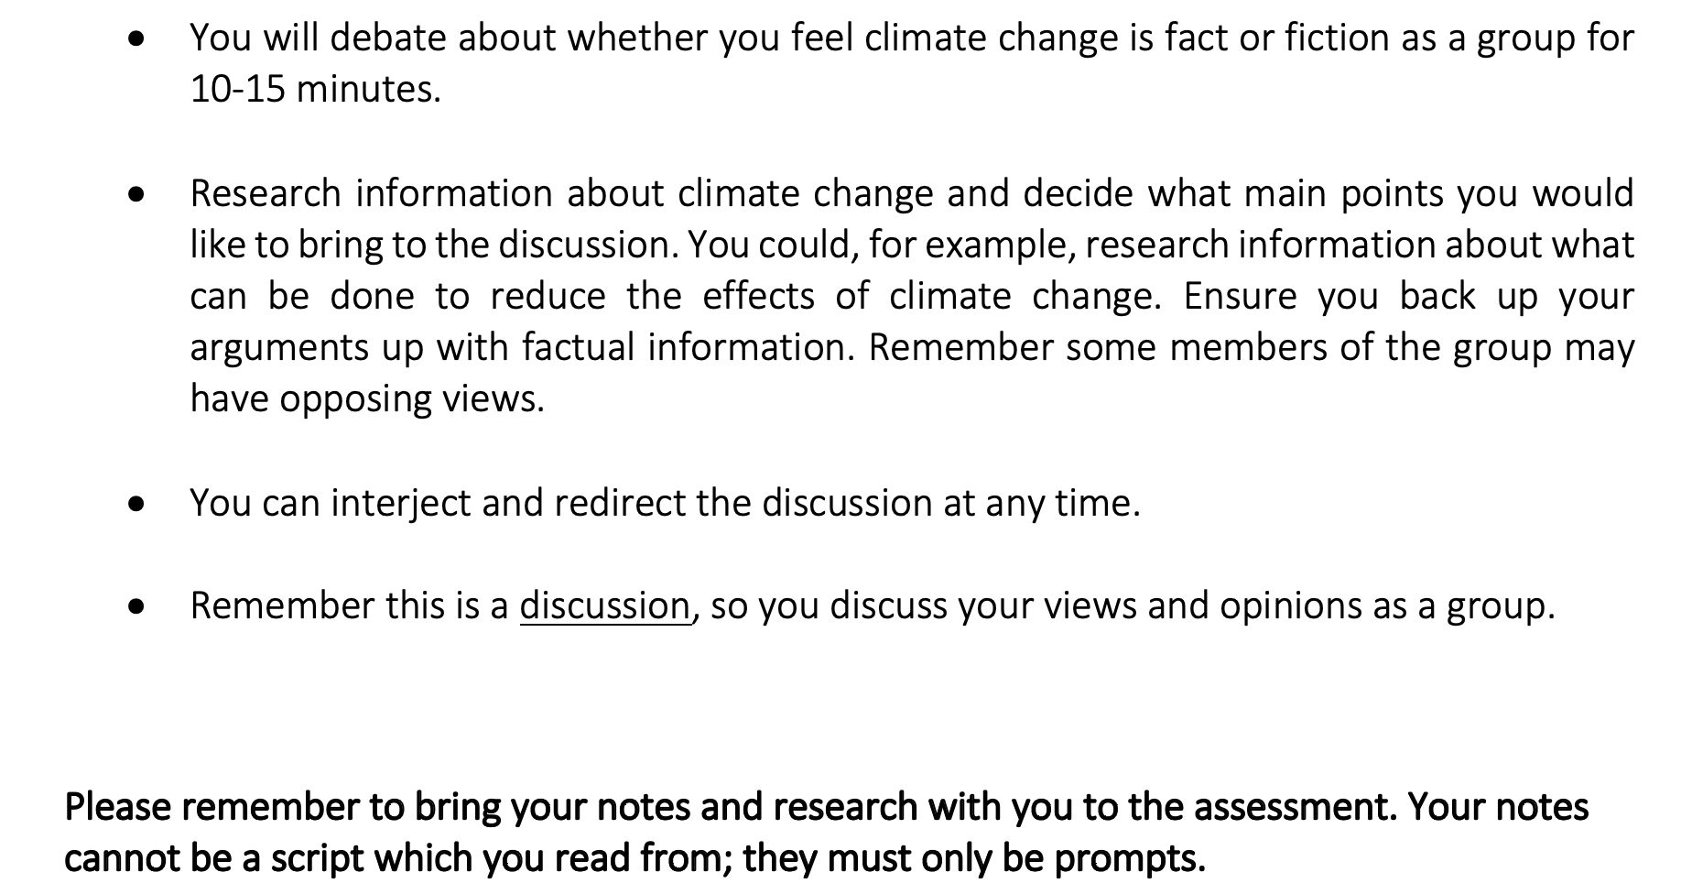

Slide 12
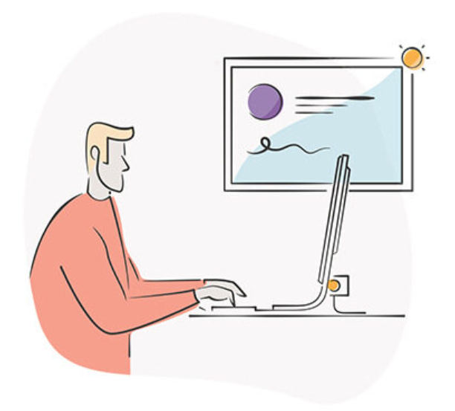
Planning
Research information about climate change and decided whether you think it is fact or fiction?
Decide what main points you would like to bring to the discussion
Research factual information to support your arguments during the discussion. Ensure that you evidence at least two different forms of research when you submit your pre-prepared work to the Functional Skills team.

Slide 13
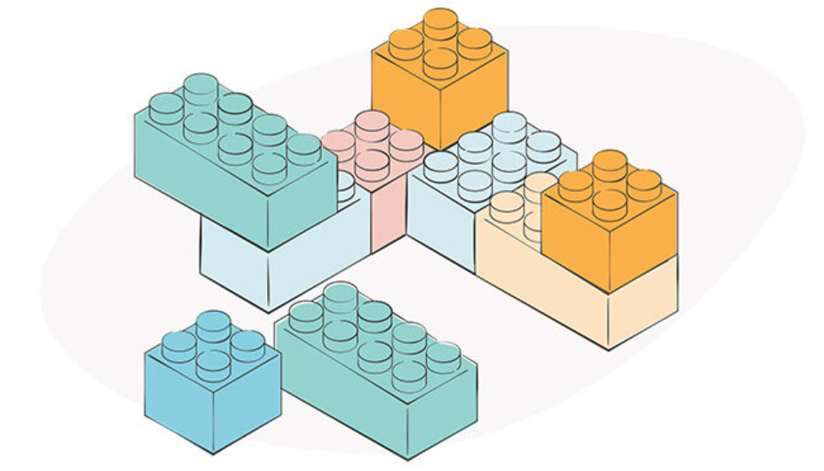
Planning Sheets
Download the planning sheet to help you to prepare for your formal discussion
You will also see some tips for interjecting and redirecting the discussion underneath the planning grid.

Slide 14
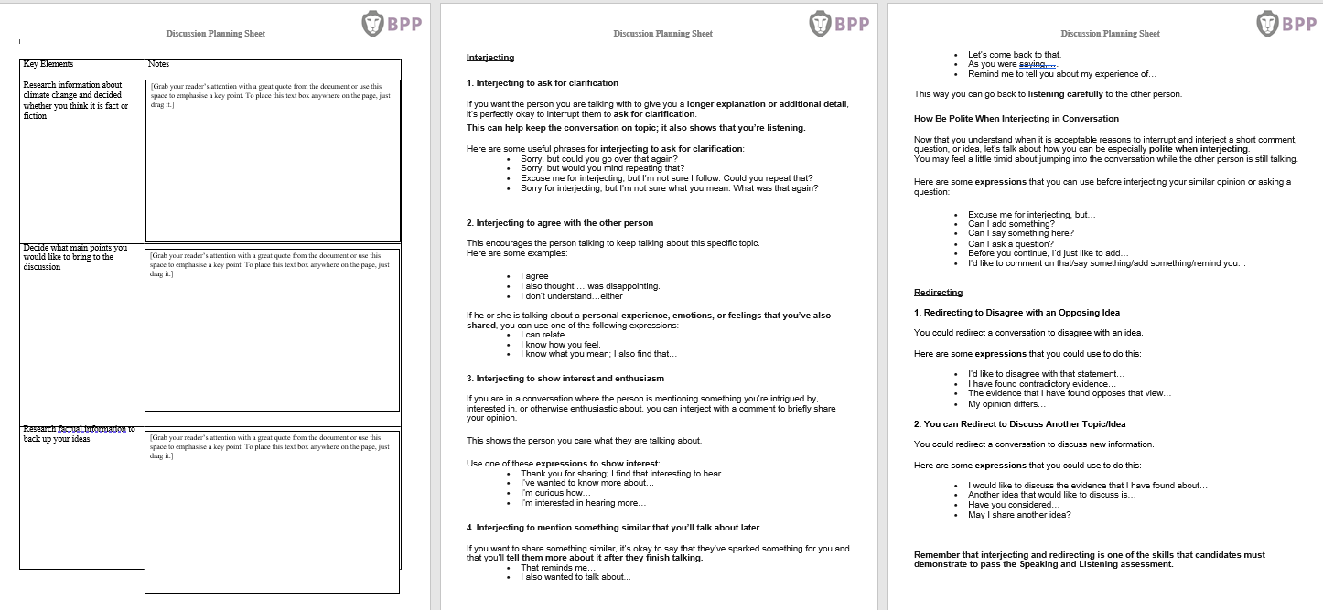
Planning Sheet

Slide 15
Structure
Unlike your presentation, the discussion is not structured
Make sure you interject and redirect the discussion, using appropriate language and register as this is a requirement to pass the assessment

Slide 16
Interjecting
Here are some good reasons to interject in a conversation:
- You can interject to ask for clarification or greater detail.
- You can interject to agree with the other person.
- You can interject to show interest and enthusiasm.
- You can interject mention that they’ve reminded you of something similar that you’ll talk about later.

Slide 17
Redirecting
Here are some good reasons to redirect a conversation:
- You can redirect to disagree with an opposing idea.
- You can redirect to discuss another topic/idea.

Slide 18
Notes
Take notes to prompt you during the discussion:
Bullet points are most effective, and it is a good idea to use a large font size
These notes should be used as prompts to guide you; you should not read directly from them

Slide 19

Any Questions?

Slide 20
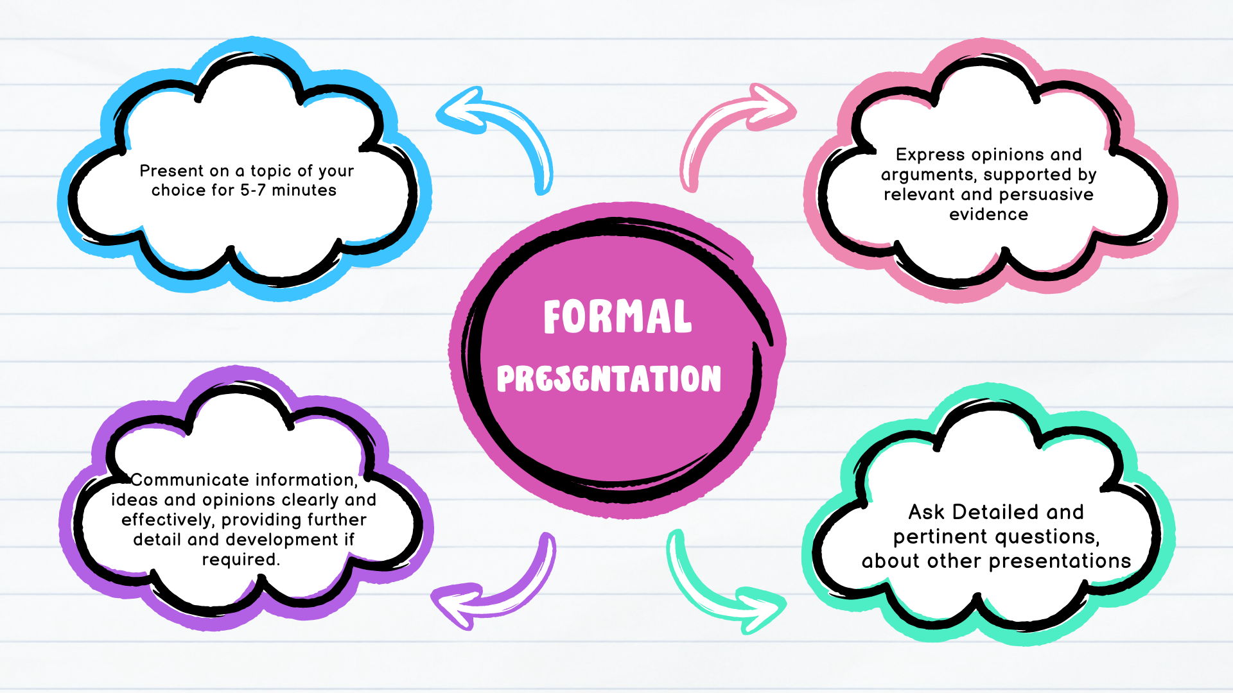
Formal Presentation (Groups of 3-4 learners)

Slide 21
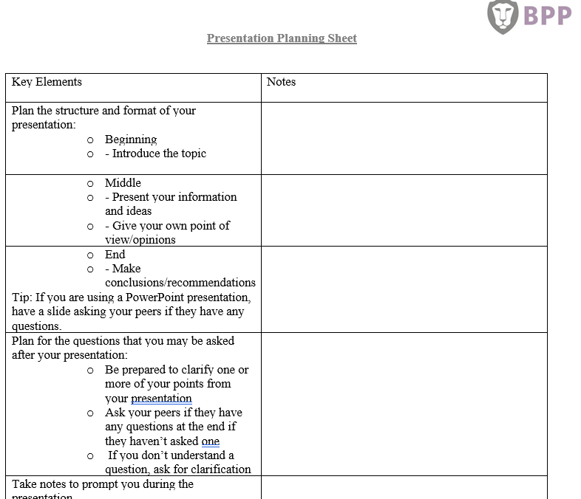
Planning
Think of a familiar topic that you would like to focus your presentation on.
Think about what you would like to achieve from your presentation. Would you like to inform, persuade, entertain or explain something to your peers when you present? Keep this in mind when you plan your ideas.
Ensure that you choose the right tone, language and level of knowledge.

Slide 22
Structure
Ensure you have three main elements to your presentation:
Beginning
Introduce yourself
Explain the main points you will cover
Middle
Go through your points logically and in sequence
End
You could use your original introduction as a summary of main points
Give a conclusion

Slide 23
Questions
Plan for the questions that you may be asked after your presentation:
Be prepared to clarify one or more of your points from your presentation
Ask your peers if they have any questions at the end if they haven’t already asked one
If you don’t understand a question, ask for clarification

Slide 24
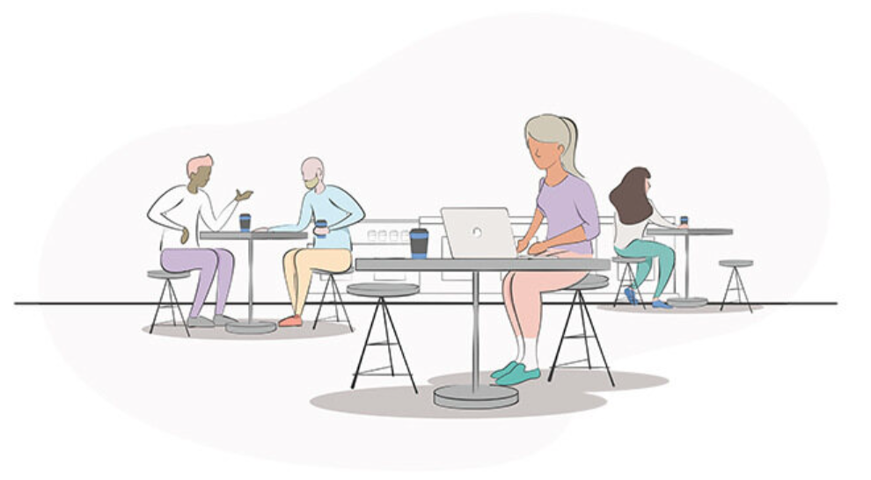
Notes
Take notes to prompt you during the discussion:
Bullet points are most effective, and it is a good idea to use a large font size
These notes should be used as prompts to guide you; you should not read directly from them

Slide 25
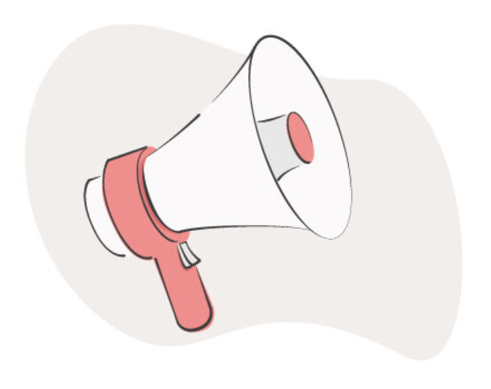
Presentation Tips
Be confident and as relaxed as you can; planning well will help you to feel confident.
If you get nervous, take deep breaths before you begin speaking to calm yourself and have a glass of water handy. Having a drink with fresh is a dry mouth and gives you a few seconds to have a break.
Nervousness can cause you to speak too quickly. Try to speak calmly and slowly to ensure your audience understands what you are saying.
Make eye contact with members of the audience and ensure you are not looking away from the screen.
Use appropriate visuals and/or a PowerPoint presentation to make your presentation exciting and interesting.
Don’t try to cover too much information. Focus on the message/information you want to get across to the audience.

Slide 26
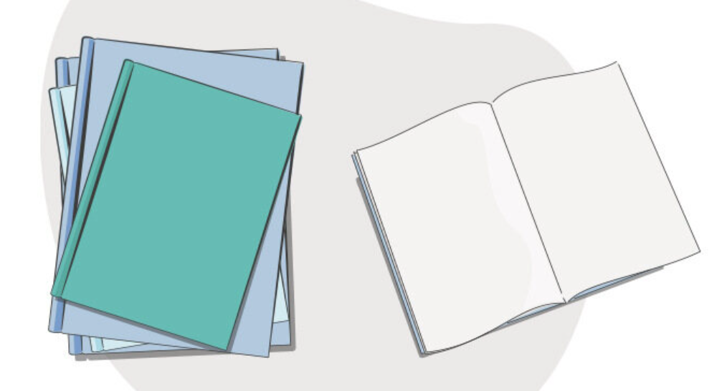
Helpful Tips
Do not read your presentation material although you can use short notes as a prompt.
Ensure you practice your presentation in front of friends and/or a mirror.
Thank your audience and ask them if they have any questions.

Slide 27
Any Questions?

Slide 28
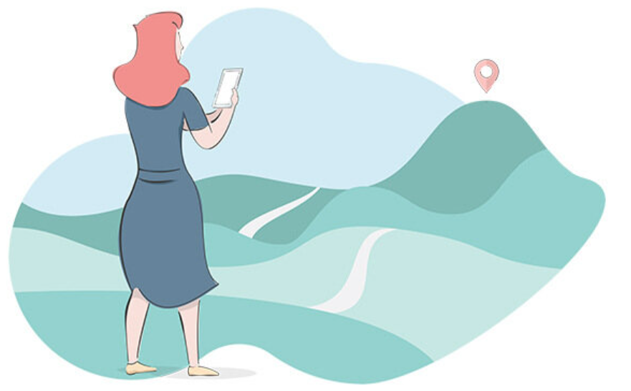
What happens next?
Review the Speaking and Listening information and planning materials
Email FunctionalSkills@bpp.com to book your assessment date
Ensure you have planned and rehearsed for the discussion and presentation
Email your resources to FunctionalSkills@bpp.com prior to your assessment date
Practice and rehearse a little more

